Slide 1
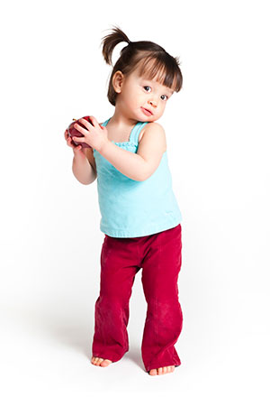
Toddler Welcome Letter
Welcome to the Toddler classroom. We are so excited to have your child _________________ joining for the 2023-2024 school year. Our Toddler classroom is a fun room. In this classroom, children are introduced to the learning world of academics and fine tuning their self-help skills. In this classroom, Toddler are learning to feed themselves. We kindly ask that you bring in food items for them to be able to feed themselves and they are introduced to the toilet.
While in this room, students are introduced to many educational and hands on learning experiences. Such experiences are the same daily schedule, art, sensory, group and individual play and fine and gross motor play.
Students are brought outside 2 times a day. In the warmer months, we tend to spend a lot of time outside exploring the world around them.
Brightwheel’s is updated when the teachers have a free moment, normally at nap time. Please note, that pictures are taken a few times a week. We do try to take as many as we can, but the health, safety, and well being of our students comes first. We that you communicate with us via Brightwheel. Communication should be open and honest, and we promises to do the same.
Please visit our website, health handbook, and parent handbook. These are very important to read.
SUPPLY LIST
Diapers
Wipes
Diaper cream (if needed)
2 changes of clothing
Enough bottles for the day, plus one additional bottle
Formula/ Milk/ Breast milk
Sippy cup with water only. Please pack a separate cup for milk. Cups to go home nightly
Water (or we have filtered here)
Pacifier (if needed)
Crib sized sheet and blanket
Lunch and PM snack
Your child’s teachers are:
Lindsay
Kristen
PM assistant Natalie
©Character in the Classroom 2019

Slide 2
Classroom Schedule
6:30-7:30 Welcome
7:30-8:30 Free Play
8:30-9:00 AM Snack (school provided)
9:00-9:30 Circle Time/ Story Time
9:30-10:30 Outside
10:30-11:00 Art/ Sensory (can be outside)
11:00-11:30 Lesson Activity (can be outside)
11:30-12:15 Lunch
12:15-2:30 Nap/ Rest
2:30-3:00 PM Snack (parent provided)
3:00-4:30 Outside
4:30-5:00 Music and Movement
5:00-6:00 Free play and heading home
Things you will find in your child’s classroom:
Math/Science wall
Loose Parts area
Language/ Lit wall
Dramatic Play (Based on Monthly theme)
Recycled Play Items
Sensory Bin
Circle time
Outside Expectations:
From the months of April to October we will spend a lot of time outside (weather depending). This includes snack, table time, circle, lunch. Inside will be used for bad weather. Children outside are be free to explore. Using water, sand, mud, and their imaginations.
Children are required to go outside daily, including infants. Please ensure your child has proper clothing for outside. This is a requirement by our state licensing
Infants-Waddlers: 35 degrees and higher
Young Toddlers-Older Toddlers: 30 degrees and higher
PS-PK: 25 degrees and higher
©Character in the Classroom 2019

