Slide 1
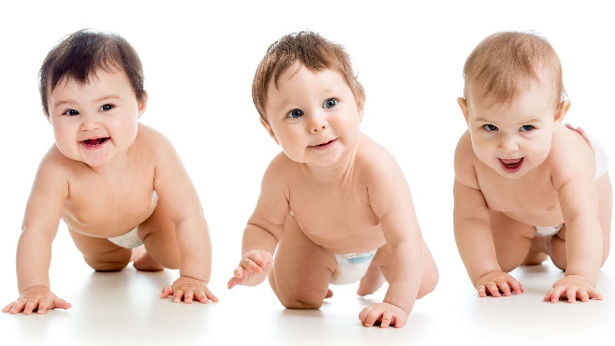
Infant Welcome Letter
Welcome to the infant classroom. We are so excited to have your child _________________ joining for the 2023-2024 school year. The infant room is a great place for students to learn to trust their caregivers. In our classroom we offer your child to learn and grow at their own pace. In this classroom, children are on their own schedule. We ask that you please provide us your child’s schedule and we will do our best to follow it. Please know, that sometimes the children like to change their own schedule as they get older. So, it is very important to always keep open and honest communication with us, and we promise to do the same. Brightwheels is updated when we have a moment, but we do try to do it on demand. Please know that sometimes we do get busy with our 12 littles and may miss a thing or two, but we truly try not to. Please remember that your child’s bottles will be send home nightly to be cleaned.
Children who are starting to eat solids are required to have them cut in dice sized pieces. We highly encourage baby-led weaning and are here to help with any questions. Owner, Kay is also highly versed in infant feeding and happy to help. While children are with us, they will learn to self-feed starting at 8 months old. This helps build those important self help and fine motor skills.
Please visit our website for infant feeding information, health handbook, and parent handbook. These are very important to read.
SUPPLY LIST
Diapers
Wipes
Diaper cream (if needed)
3 changes of clothing
Enough bottles for the day, plus one additional bottle
Formula/Breast milk
Water (or we have filtered here)
Pacifier (if needed)
Sleep sack
Sleep swaddle (once babies roll over they can’t be used)
Your child’s teachers are:
Shannon
Kelsey
PM Assistant Leo
©Character in the Classroom 2019

Slide 2
Classroom Schedule Example
6:30-7:30 Welcome
7:30-8:00 Breakfast
8:00-8:30 Diaper Changes
8:30-9:30 Free-Play, tummy time, stories9:30-10:30 AM Walk/ Lawn
10:30-11:00 Diaper Changes
11:00 Nap for older students over 6 months
11:00-12:00 Free-Play sensory
12:00-12:30 Diapers
12:30-1:00 Lunch time
1:00-2:00 Outside
2:00-2:30 Diaper Changes
2:00 Nap for older students over 6 months
2:30-3:00 Art
3:00-4:00 Outside
4:00-4:30 Diapers
4:30-5:30 Free-play
5:30-6:00 Combine and heading home
Things you will find in your child’s classroom:
Bouncy seat
Floor Swing
Highchairs
Cribs
Fine and Gross motor toys
Teethers
Outside Expectations:
From the months of April to October we will spend a lot of time outside (weather depending). This includes snack, table time, circle, lunch. Inside will be used for bad weather. Children outside are be free to explore. Using water, sand, mud, and their imaginations.
Children are required to go outside daily, including infants. Please ensure your child has proper clothing for outside. This is a requirement by our state licensing
  Infants-Waddlers: 35 degrees and higher
  Young Toddlers-Older Toddlers: 30 degrees and higher
  PS-PK: 25 degrees and higher
©Character in the Classroom 2019

